Slide 1

Solution Sales Training
SW-640L-TX-W
Powerful · Reliable · Simple

Slide 2
SW-640L-TX-W – Why It’s Used in Modern Conference Rooms
What is BYOD Presentation Switching?
A plug-and-play method for connecting any device to a room display — wired or wireless, with no apps required
Supports Miracast, AirPlay Mirroring, Google Cast, and USB-C Dongle casting up to 4K@30Hz
Why BYOD Presentation Switching is Utilized:
Universal Device Compatibility
Works with Windows, macOS, iOS, and Android devices
App-free and driver-free — no software to install on user devices
High-Quality Wired & Wireless Video
2x HDMI + 2x USB-C inputs up to 4K@30Hz; dual HDMI outputs up to 4K@60Hz
USB-C Dongle casting at 4K@30Hz; wireless conference camera at 1080P@30Hz
Wireless Conferencing (BYOM)
Wirelessly shares room cameras and speakerphones to meeting software (Teams, Zoom)
Enables hybrid meeting experiences without dedicated room PCs
Powerful Network & USB Infrastructure
5x GbE ports (3x RJ45, 2x embedded in USB-C) eliminates need for extra network switches
Built-in USB 3.0 hub and 60W USB-C charging for a clean, cable-minimal setup
Powerful · Reliable · Simple

Slide 3
Opportunity
Rapid Market Growth: BYOD and wireless collaboration are becoming standard in corporate, education, and government AV deployments as organizations modernize their meeting spaces.
Lowered Adoption Barriers: The SW-640L-TX-W supports Miracast, AirPlay, and USB-C Dongle casting.
Integration with Hybrid Work: The rise of hybrid work has made wireless conferencing (BYOM) essential. Users expect to walk in and share their screen and room camera wirelessly — without IT involvement or app installs.
Strategic Versatility: Major industry players like Sony, Zoom, and and Apple are adopting the standard, signaling long-term viability and stability for investments.
SW-640L-TX-W is not just a presentation switcher.
It is a market expansion technology that:
Eliminates cable clutter
Enables wireless-first AV
Expands AV into IT-friendly workflows
Increases user adoption and room utilization
Powerful · Reliable · Simple

Slide 4
Design Considerations
Organizations face several key challenges:
Infrastructure Limitations
Meeting rooms rely on fixed HDMI wall plates, limiting which devices and locations can present
Device Compatibility Constraints:
Different laptop brands, operating systems, and ports create a fragmented connection experience
Operational Inefficiency:
Managing separate wired switching, wireless casting, and conferencing peripherals creates complexity and AV support burden
Powerful · Reliable · Simple

Slide 5
Corporate Conference & Meeting Rooms
Powerful · Reliable · Simple

Slide 6
Bridging Wireless BYOD and Traditional Wired AV
Two Collaboration Worlds — Better Together
💻 BYOD / Wireless Collaboration
Focused on Flexible User Access
Laptops, phones, tablets, and dongles
Works with Miracast, AirPlay, Google Cast, USB-C
Wireless casting and BYOM conferencing
Ideal for ad-hoc sharing and hybrid meetings
➡ Answers: “How do users share content?”
🖥️ Wired AV Distribution
Focused on Reliable Display Output
Fixed HDMI inputs and display routing
Dual displays, Quad-view multiview
Integrated with control systems and USB peripherals
➡ Answers: “How do we route content to displays?”
Powerful · Reliable · Simple

Slide 7
Wireless Casting Protocol Comparison
Feature | Miracast | AirPlay Mirroring | Google Cast | USB-C Dongle (APO-DG2)
Primary Use Case | Windows/Android screen mirroring | Apple device screen mirroring | Chrome/Android casting | Universal 4K casting via hardware dongle
Compression Type | H.264/H.265 compressed | H.264/H.265 compressed | H.264/H.265 compressed (advanced) | Intra-frame
Typical Latency | 150–300 ms | 100–200 ms | 200–400 ms | ~100 ms
Bandwidth (1080p60) | Varies (compressed) | Varies (compressed) | Varies (compressed) | ~15–30 Mbps
Bandwidth (4K60) | Not supported | 4K@30Hz limited | 4K@30Hz limited | 4K@30Hz supported
Network Requirement | Wi-Fi 5 (802.11ac) | Wi-Fi 5 (802.11ac) | Wi-Fi 5 (802.11ac) | Wi-Fi 5 (802.11ac)
Video Quality | Good (compressed) | Good (compressed) | Good (compressed) | Best (near lossless)
Frame Accuracy | Good | Good | Good | Very good
Discovery / Routing | Auto (Wi-Fi Direct) | Auto (Bonjour) | Auto (mDNS) | Manual pairing
Scalability | High | High | High | Medium
Typical Latency Sensitivity Use | Presentation sharing | Apple content sharing | Chrome/browser casting | High-quality 4K sharing
Best Strength | Wide device compatibility | Apple ecosystem | Google/Android ecosystem | 4K quality + no app needed
Main Tradeoff | Variable quality | Apple devices only | Limited to Google ecosystem | Requires hardware dongle
Powerful · Reliable · Simple

Slide 8
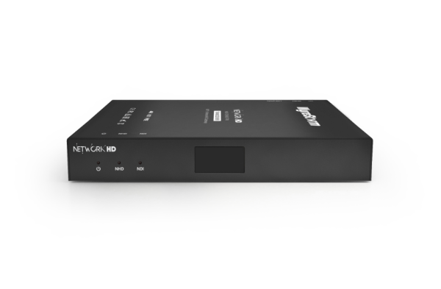
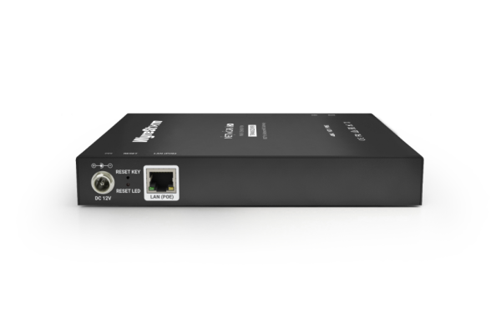
What is the SW-640L-TX-W?
SW-640L-TX-W
BYOD 4×2 Presentation Switcher
• 2× HDMI and 2× USB-C inputs up to 4K@30Hz for wired BYOD connections • 2× HDMI outputs up to 4K@60Hz with independent dual-display support • App-free wireless casting via Miracast, AirPlay Mirroring, and Google Cast • USB-C Dongle (APO-DG2) casting at 4K@30Hz — no software install required • Wireless Conference (BYOM): share room camera and speakerphone wirelessly via dongle • Built-in 5-port GbE network hub with hardware-level network security • 60W USB-C charging, USB 3.0 hub, and quad-view multiview support
Powerful · Reliable · Simple

Slide 9
System Diagram
Powerful · Reliable · Simple

Slide 10
Comparison to Competition
Feature | WyreStorm | Barco | Crestron | Extron | Barco (CX-50) | WyreStorm Advantage
Model | SW-640L-TX-W | CX-50 2nd Gen | AM-3200-WF | ShareLink Pro 2500 | CX-50 | —
Primary Function | BYOD 4×2 Presentation Switcher | Wireless Presentation | Wireless Presentation | Wireless Presentation | Wireless Presentation | ✅ Most flexible wired + wireless solution
Input | 2× HDMI + 2× USB-C (4K@30Hz) | 1× USB-C (video only) | 1× HDMI | 1× HDMI | 1× HDMI | ✅ 4 inputs vs 1 on competitors
Output | 2× HDMI (4K@60Hz) | 1× HDMI or USB-C | 1× HDMI | 1× HDMI | 2× HDMI | ✅ Dual independent display outputs
Wireless Casting | Miracast + AirPlay + Google Cast + Dongle | Miracast + AirPlay + Google Cast | Miracast only | Miracast + AirPlay + Google Cast | Miracast + AirPlay + Google Cast | ✅ Most casting protocols supported
Dongle Casting | 4K@30Hz (no app) | 4K@30Hz (app required) | 4K@30Hz (no app) | Not available | ✅ | ✅ 4K dongle, app-free
BYOM (Wireless Conference) | ✅ Supported | ✅ Supported | ✅ Supported | ✅ Supported | ✅ Supported | — Similar
USB-C Input | ✅ 2× Full-function (video+USB+LAN+60W) | ✅ 1× (video only) | ❌ None | ❌ None | ❌ None | ✅ Full-function USB-C with charging
Network Ports | 5× GbE (3× RJ45 + 2× USB-C) | 1× RJ45 (2.5G) | 2× RJ45 | 1× RJ45 | 2× RJ45 | ✅ Built-in network hub, no extra switch needed
Multiview | Quad View | Dual View | Quad View | Dual View | Quad View | ✅ Quad-view for richer collaboration
HDCP Support | ✅ | ❌ | ✅ | ❌ | ✅ | ✅ HDCP where competitors lack it

Slide 11
Vertical 1 (Corporate Boardroom)
Problem:
Multiple presenter devices (Mac, PC, phone) with different ports
Guests connect via Zoom/Teams from their own laptop
Room needs to share a camera and speakerphone wirelessly
How the SW-640L-TX-W Helps:
4 inputs (2× HDMI + 2× USB-C) handle any laptop or device
App-free Miracast/AirPlay/Google Cast for all OS types
BYOM via USB-C Dongle shares room camera to Teams/Zoom wirelessly
Dual HDMI outputs let presenter view differ from audience display
Powerful · Reliable · Simple

Slide 12
Vertical 2 (Education/Classrooms)
Problem:
Teachers and students present from different devices (Mac, PC, Chromebook)
Schools require zero-install solutions — no admin rights on student devices
How the SW-640L-TX-W Helps:
Miracast, AirPlay, and Google Cast cover Windows, Apple, and Chromebook
USB-C input with 60W charging keeps teacher laptop powered during class
Quad-view multiview lets instructor show multiple sources simultaneously
Powerful · Reliable · Simple

Slide 13
Vertical 3 (Healthcare & Government)
Problem:
Strict Security & Compliance Requirements
Visitor devices (contractor laptops, tablets) must not access internal network
Clinical or sensitive rooms cannot have installed software on presenter devices
Rooms require USB peripherals (cameras, mics) for telehealth or remote briefings
Multiple displays needed: presenter view vs. audience view
These requirements call for hardware-level network isolation and app-free operation.
Most wireless presentation systems cannot meet all of these needs simultaneously.
How the SW-640L-TX-W Helps:
Hardware-level port-based network isolation keeps visitor and internal traffic separate
App-free wireless casting (Miracast/AirPlay/Google Cast) — nothing installed on user device
BYOM enables telehealth/video conferencing with room camera/mic via USB-C Dongle
Powerful · Reliable · Simple

Slide 14
Benefits
1. Only Unit with Full-Function Dual USB-C Inputs
Competitors typically offer:
1× USB-C, video only
No USB data, no charging
No embedded LAN in USB-C
WyreStorm SW-640L-TX-W:
2× full-function USB-C (video + USB 3.0 + GbE + 60W charging)
MST support: each USB-C carries 2 simultaneous video signals
Works as a network hub — no extra switch required
2. 4K Dongle Casting Without an App
Competitors require:
App installation on user device
Lower casting resolution (720P–1080P)
SW-640L-TX-W:
4K@30Hz dongle casting — zero software on user device
Powerful · Reliable · Simple

Slide 15
Y.S.K
You should know:
USB host switching takes 10–15 seconds
Multiview only works with single display (not dual display mode)
Wireless conference camera max resolution is 1080P@30Hz via dongle
App installation required for Wireless CONFERENCING
Do NOT position as:
A seamless KVM switch
A standalone wireless display adapter
Position as:
All-in-one BYOD hub for modern meeting rooms
The single device that handles wired, wireless, and conferencing
Powerful · Reliable · Simple

Slide 16
Questions?
Powerful · Reliable · Simple

